Slide 1

DESIGN & OPTIMIZATION OF EFFICIENT LEAD-FREE PEROVSKITE BASED TANDEM SOLAR CELL
Presented by
Mashrife Jaman Radib
ID : 1802007
Abrar Adib
ID : 1802019
Supervised by Mrinmoy Dey Associate Professor Dept. of EEE, CUET
Department of Electrical and Electronic Engineering Chittagong University of Engineering and Technology

Slide 2
Presentation Outline
Objectives.
Background and Present State of Problem.
Why Solar Energy.
Methodology.
Design and Simulation of Proposed Tandem Cell.
Results and Discussions.

Slide 3
Objectives
i. Detailed discussion about the Perovskite tandem solar cell for higher power conversion efficiency
ii. Modeling & simulation of tandem solar cells with Perovskite as top cell and Si, GeTe and CuInSe₂ as bottom cell
iii. Performance analysis and comparative study of the proposed tandem solar cells

Slide 4
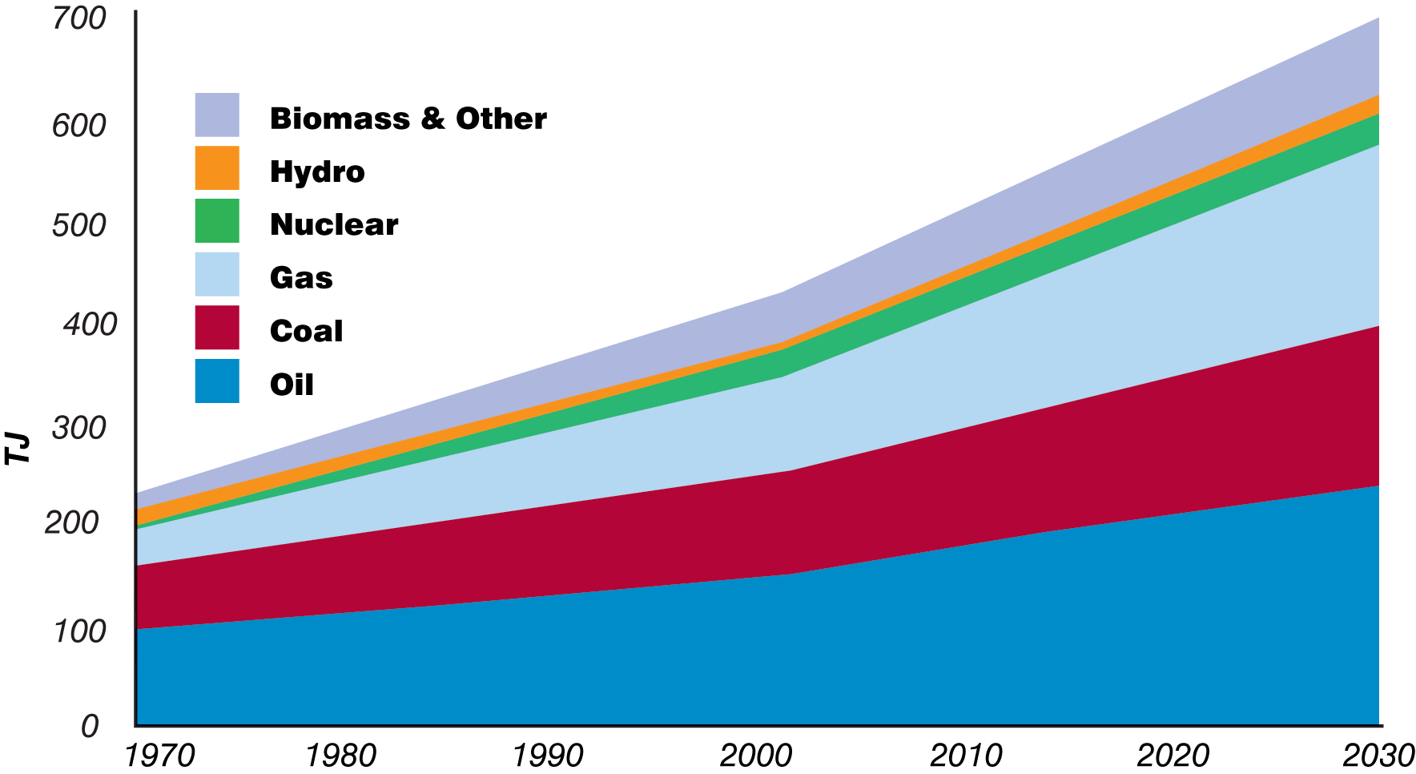
Background and Present State of the Problem
Global energy consumption is rising.
The supply of fossil fuels will be over soon.
Global warming.
GHG emission.
Figure 1 : Rising Global Energy Consumption [1]

Slide 5






Alternative : Renewable Energy Sources
Solar Energy
Wind Energy
Hydro Energy
Biomass Energy
Geothermal Energy
Figure 2 : Renewable Energy Sources

Slide 6






Solar Energy
Lowers carbon footprint
Advances clean energy technology
Supports local economy
Backs up grid energy
Long lifespan
Figure 3 : Solar Panels

Slide 7
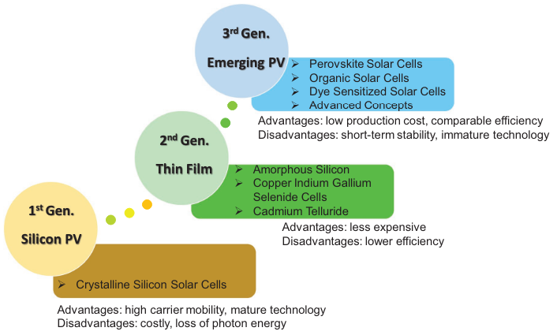
Evolution of Solar Cells
Figure 5 : Classification of Solar Cells [3]

Slide 8





Why Perovskite Solar Cell
Lower production cost
Better efficiency
High absorption coefficient
Long diffusion length
Good carrier mobility

Slide 9
Literature Review of Single Junction Cells
Device Structure | V_{oc} (volts) | J_{sc} (mA/cm²) | FF (%) | PCE (%) | Ref.
Glass-base / FTO / Cd_{0.5}Zn_{0.5}S / MASnI₃ / MASnBr₃ / Au | 0.96 | 32.48 | 76.40 | 23.86 | [4]
ITO/ZnO/MASnI₃/ CuSbS₂/Ag | 0.876 | 33.19 | 76.19 | 22.16 | [5]
FTO/TiO₂/MASnBr₃/ NiO/Au | 0.80 | 31.88 | 84.89 | 21.66 | [6]
ITO/ZnO/MASnBr₃/Spiro-OMeTAD/Au | 1.01 | 32.42 | 75.67 | 25.02 | [7]
FTO/SnO₂/MAPbI₃/Spiro-OMeTAD/Au | 1.32 | 22.93 | 79.39 | 23.22 | [8]

Slide 10
Literature Review of Tandem Cells
Device Structure | V_{oc} (volts) | J_{sc} (mA/cm²) | FF (%) | PCE (%) | Ref.
CH₃NH₃PbI₃ / CIGS | 1.81 | 20.49 | 81.90 | 30.50 | [9]
CH₃NH₃PbI₃ / GeTe | 1.747 | 25.88 | 79.40 | 35.90 | [10]
CH₃NH₃PbI₃ / Si | 2.11 | 20.95 | 79.45 | 35.30 | [11]
MAGeI₃ / FASnI₃ | 2.62 | 14.69 | 79.80 | 30.86 | [12]

Slide 11
Methodology
STEP 01
Selection of Reference Cell
STEP 02
Design and Optimization of Top Cell
STEP 03
Comparison With the Reference Cell
STEP 04
Design and Optimization of Bottom Cell
STEP 05
Current Matching Between Two Cells
STEP 06
Perform the Simulation of Tandem Cell

Slide 12
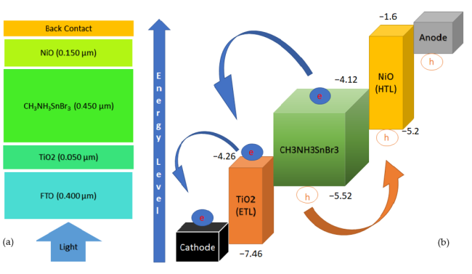
Reference Cell for Perovskite Top Cell
Cells | V_{oc} (V) | J_{sc} (mA/cm²) | FF (%) | PCE (%)
Reference Cell | 0.80 | 31.88 | 84.89 | 21.66
Our Simulation | 0.78 | 30.43 | 84.35 | 20.03
Figure 7 : Structure and Band Simulation of the Reference Cell [6]

Slide 13
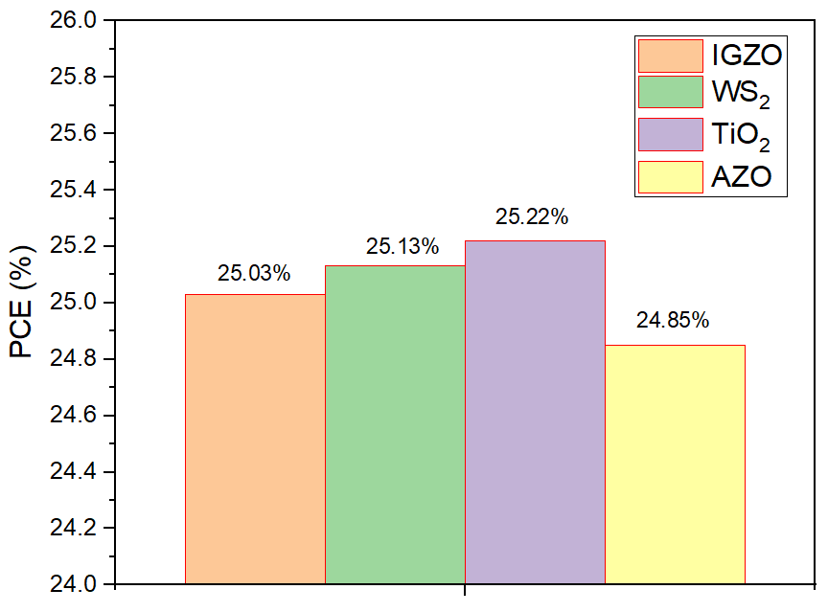
Selection of ETL for Perovskite Top Cell
Device Structure | J_{sc} (mA/cm²) | V_{oc} (volts) | FF (%) | PCE (%)
ITO/TiO₂/MASnBr₃/Au | 29.53 | 1.06 | 80.37 | 25.22
ITO/WS₂/MASnBr₃/Au | 29.64 | 1.05 | 79.9 | 25.13
ITO/IGZO/MASnBr₃/Au | 29.43 | 1.06 | 80.21 | 25.03
ITO/AZO/MASnBr₃/Au | 29.40 | 1.061 | 79.7 | 24.85
Figure 8 : PCE for Various ETL Layers

Slide 14
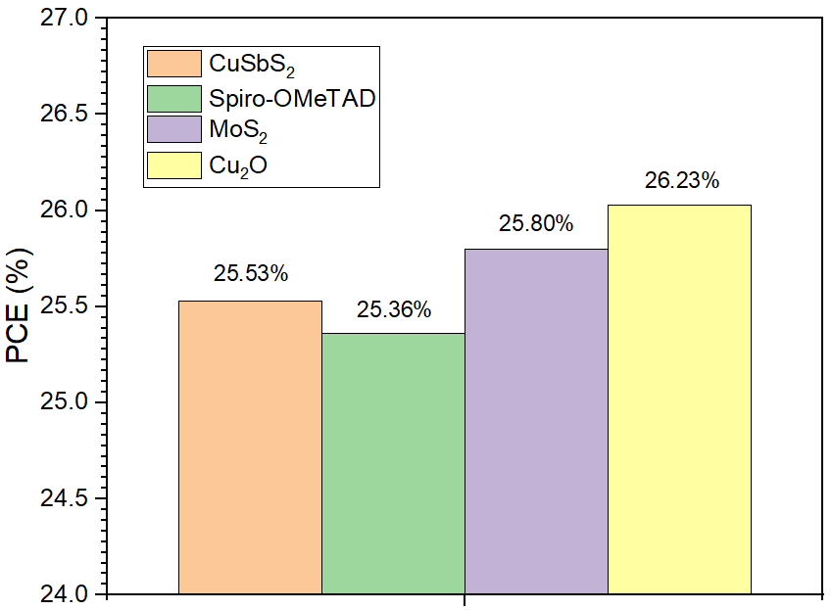
Selection of HTL for Perovskite Top Cell
Device Structure | J_{sc} (mA/cm²) | V_{oc} (volts) | FF (%) | PCE (%)
ITO/TiO₂/MASnBr₃/CuSbS₂/Au | 30.51 | 1.046 | 80.85 | 25.53
ITO/TiO₂/MASnBr₃/Spiro-OMeTAD/Au | 30.32 | 1.045 | 78.35 | 25.36
ITO/ TiO₂/MASnBr₃/MoS₂/Au | 32.10 | 1.043 | 77.12 | 25.80
ITO/ TiO₂/MASnBr₃/Cu₂O/Au | 30.85 | 1.048 | 80.43 | 26.23
Figure 9 : PCE for Various HTL Layers

Slide 15
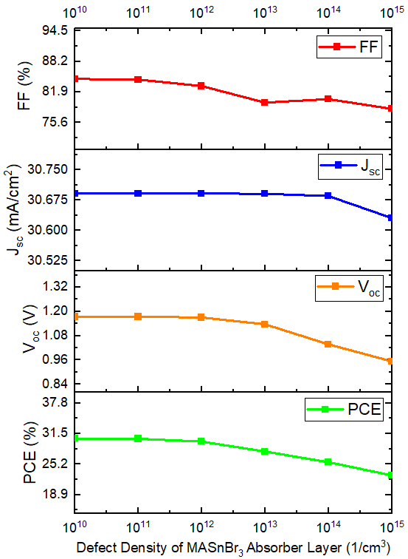
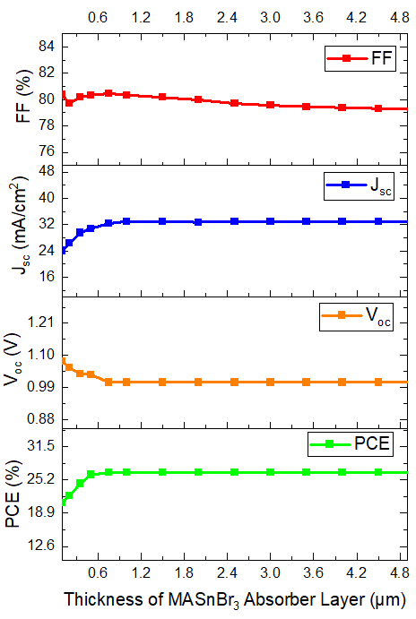
Optimization of MASnBr₃ Absorber Layer
Figure 10 : MASnBr₃ Absorber layer Thickness
Optimization
Figure 11 : MASnBr₃ Absorber layer Doping density
Optimization
Figure 12 : MASnBr₃ Absorber layer Doping density
Optimization
Thickness = 500 nm
Acceptor Density = 1×10¹⁶/cm³
Defect Density = 1×10¹³/cm³

Slide 16
Proposed Structure for MASnBr₃ Perovskite Top Cell
AM 1.5G Spectrum
Glass substrate
ITO
Thickness = 50 nm
Donor Density = 1×10¹⁸/cm³
TiO₂
CH₃NH₃SnBr₃
Thickness = 100 nm
Acceptor Density = 1×10¹⁹/cm³
Cu₂O
Au
Figure 13 : Structure of Perovskite Top Cell

Slide 17
Energy Band Alignment Diagram of Perovskite Top Cell
E
n
e
r
g
y
L
e
v
e
l
-3.2
Cu₂O
(HTL)
e
-4.17
e
-4.2
MASnBr₃
TiO₂
_{(ETL)}
e
Anode
Cathode
h
-5.37
h
-5.5
h
-7.46
Figure 14 : Energy band alignment diagram of Perovskite Top Cell

Slide 18
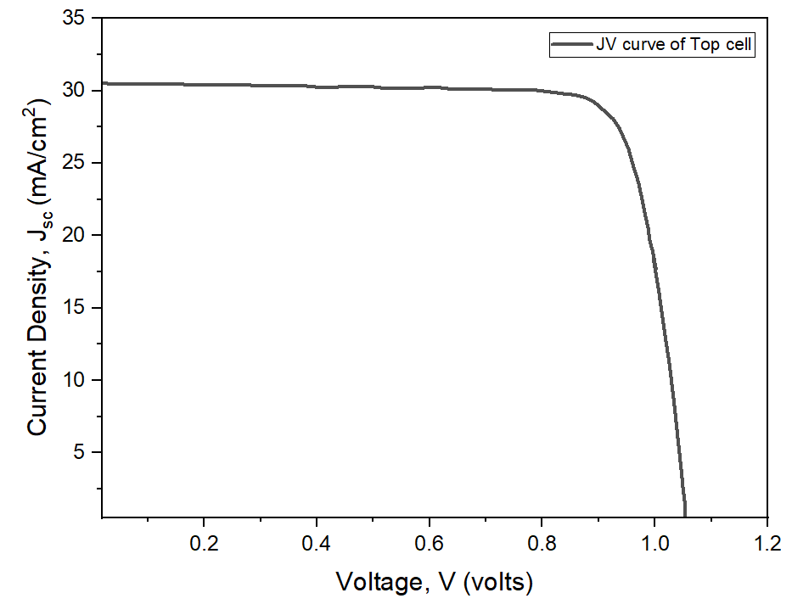
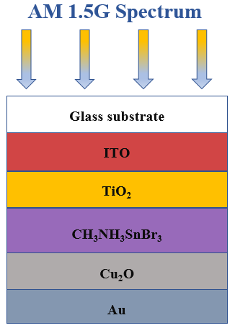
Simulation Output of MASnBr₃ Perovskite Top Cell
Simulation Output of Optimized Perovskite based Top Cell
V_{oc} (V) | J_{sc} (mA/cm²) | FF (%) | PCE (%)
1.04 | 30.75 | 80.66 | 26.20
Figure 15 : JV curve of MASnBr₃ based Top Cell

Slide 19
Thermal Stability of MASnBr₃ Perovskite Top Cell
The temperature coefficient of the perovskite based top cell is found to be about -0.183% per ºC.
Figure 16 : Effect of Temperature Variation on Top Cell

Slide 20
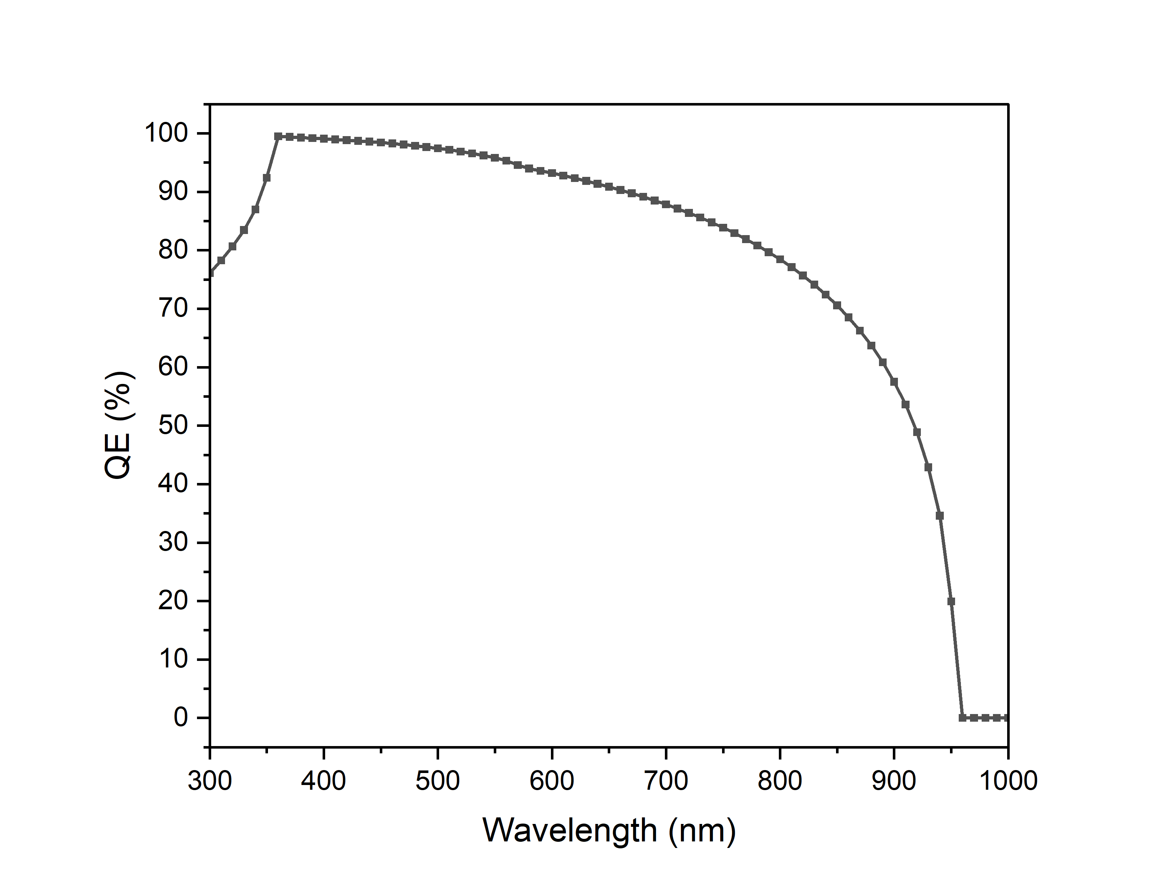
Quantum Efficiency of Perovskite Top Cell
Figure 17 : QE vs wavelength curve of Top Cell

Slide 21
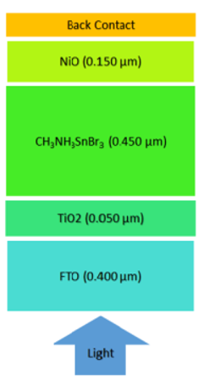
Comparison of the Optimized Top Cell With Reference Cell
Reference Cell
Proposed Cell
Simulation Output of Reference Cell
Simulation Output of Proposed Top Cell
V_{oc} (V) | J_{sc} (mA/cm²) | FF (%) | PCE (%)
0.80 | 31.88 | 84.89 | 21.66
V_{oc} (V) | J_{sc} (mA/cm²) | FF (%) | PCE (%)
1.04 | 30.75 | 80.66 | 26.20

Slide 22
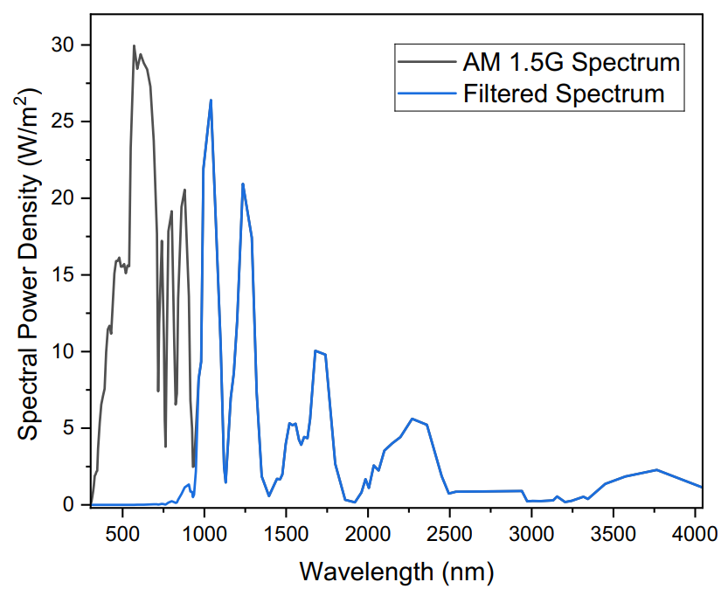
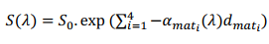
AM 1.5G and Filtered Spectrum
The filtered spectrum can be calculated from the following formula :
Figure 18 : AM 1.5G and Filtered Spectrum

Slide 23
Structure of Si Bottom Cell
Filtered/Transmitted Spectrum
FTO
c-Si (n)
Thickness = 50 nm
Donor Density = 1×10¹⁹/cm³
c-Si (p)
c-Si (p+)
Thickness = 100 nm
Acceptor Density = 9.5×10¹⁸/cm³
Au
Figure 19 : Structure of c-Si Bottom Cell

Slide 24
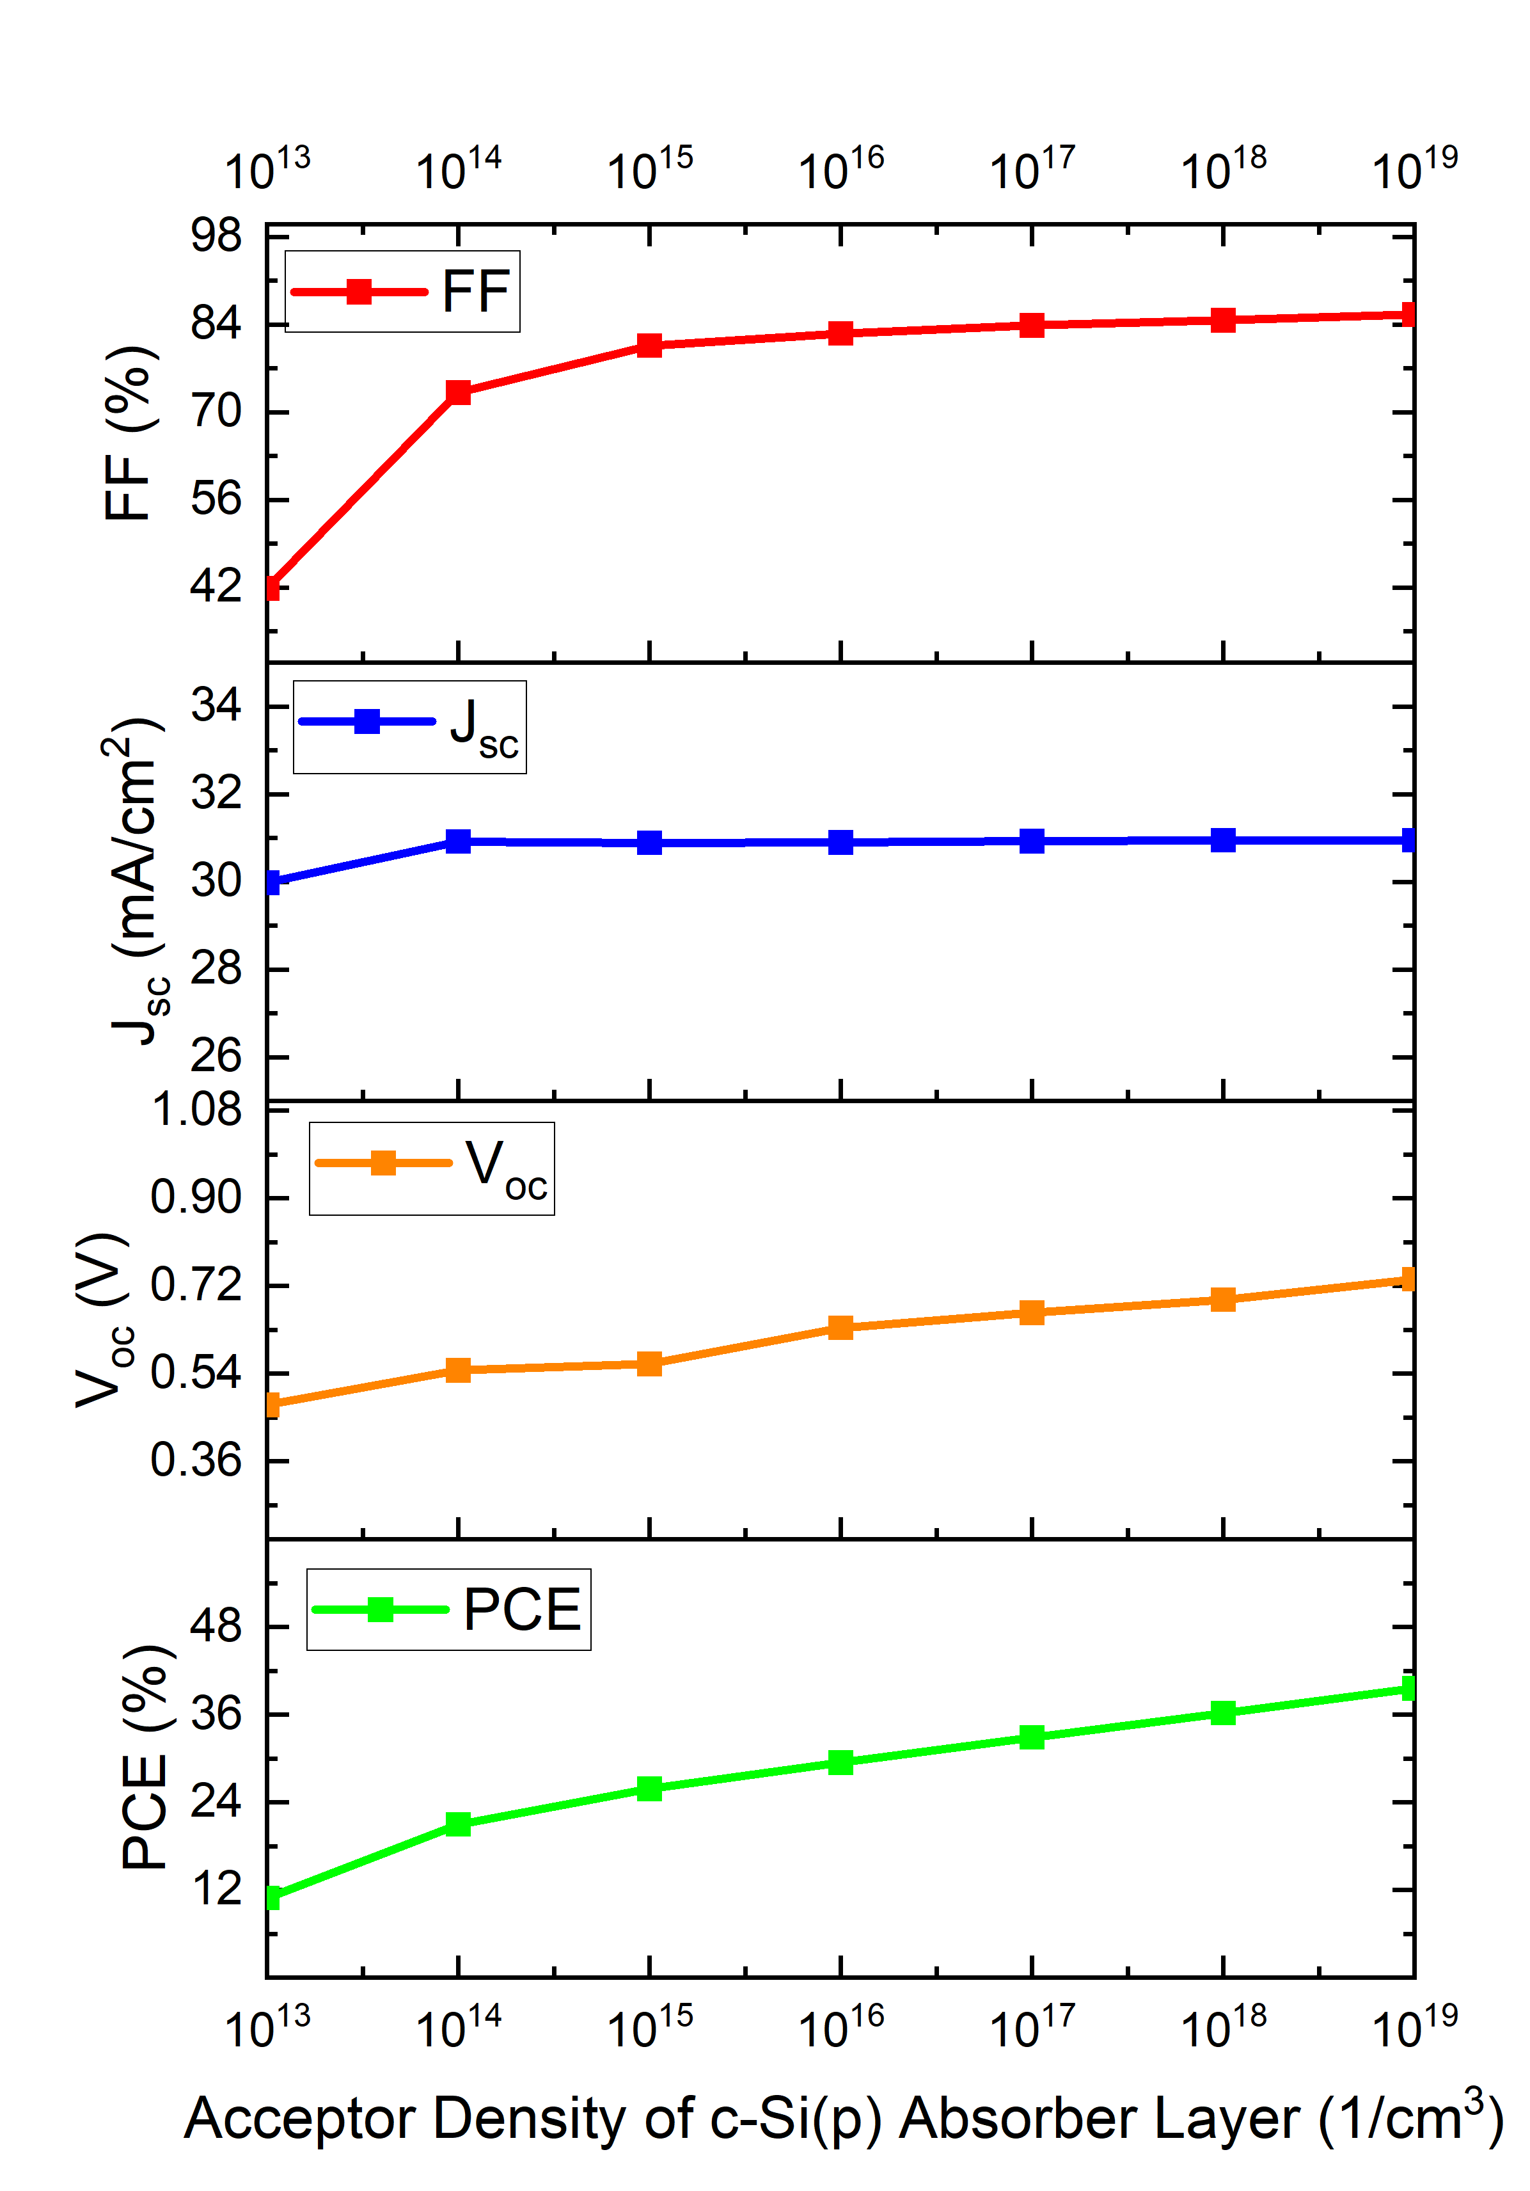
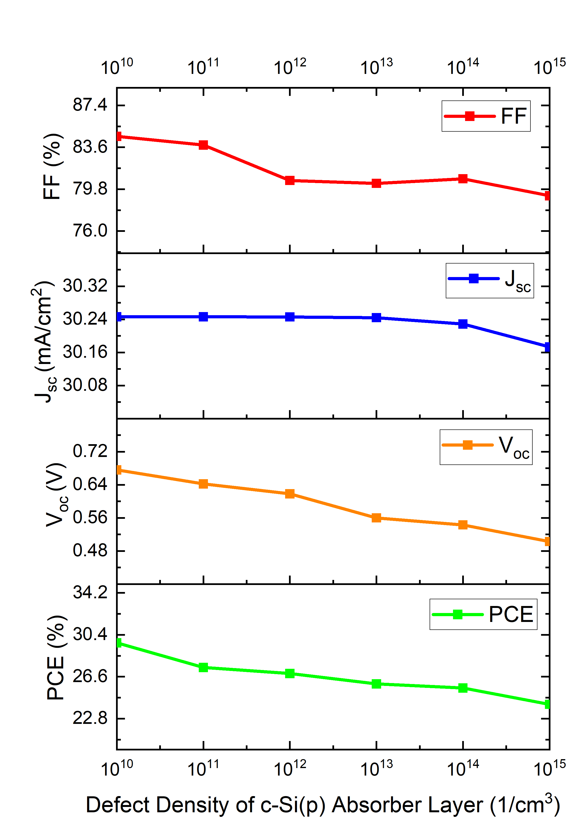
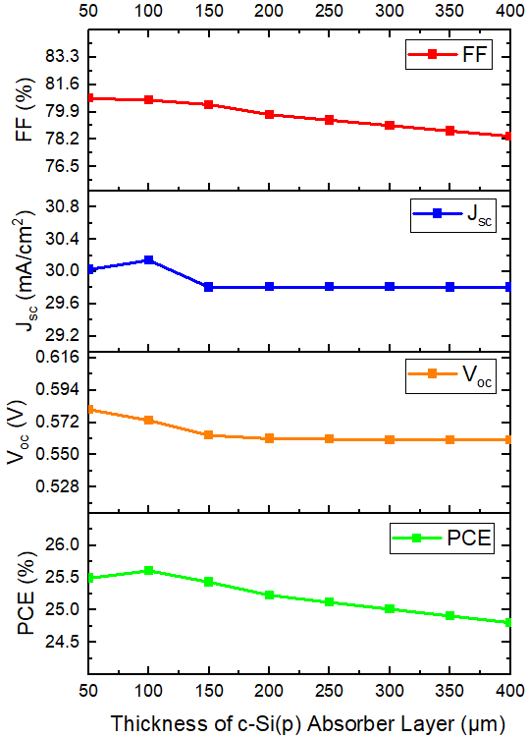
Optimization of Si Absorber Layer
Figure 20 : c-Si (p) Absorber layer Thickness
Optimization
Figure 21 : c-Si (p) Absorber layer Acceptor Density
Optimization
Figure 22 : c-Si (p) Absorber layer Defect Density
Optimization
Thickness = 100 μm
Acceptor Density= 1×10¹⁵/cm³
Defect Density = 1×10¹³/cm³

Slide 25
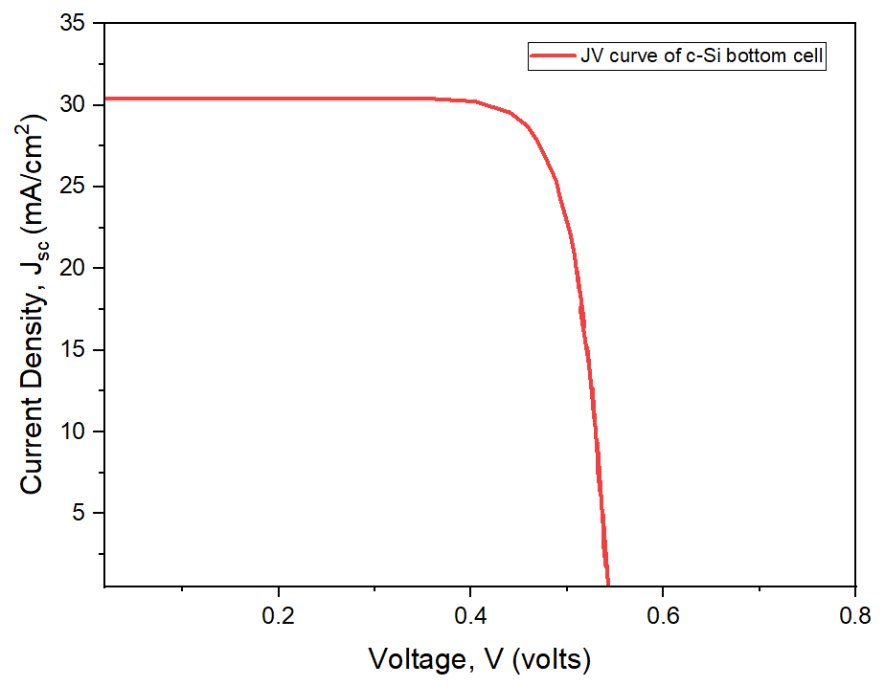
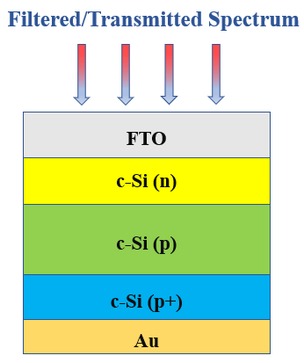
Simulation Output of Si Bottom Cell
Simulation Output of Optimized Si Bottom Cell
V_{oc} (V) | J_{sc} (mA/cm²) | FF (%) | PCE (%)
0.56 | 30.85 | 80.65 | 25.84
Figure 23 : JV curve of Si Bottom Cell

Slide 26
MASnBr₃/Si Tandem Cell
AM 1.5G Spectrum
The top cell will absorb high energy photons due to its higher energy bandgap.
The lower energy photons are passed on towards the bottom cell and get absorbed.
Glass Substrate
ITO
TiO₂
Top Sub-cell
CH₃NH₃SnBr₃
Cu₂O
Filtered/Transmitted Spectrum
FTO
c-Si (n)
c-Si (p)
Bottom Sub-cell
c-Si (p+)
Au
Figure 25 : Structure of MASnBr₃/c-Si Tandem Cell

Slide 27
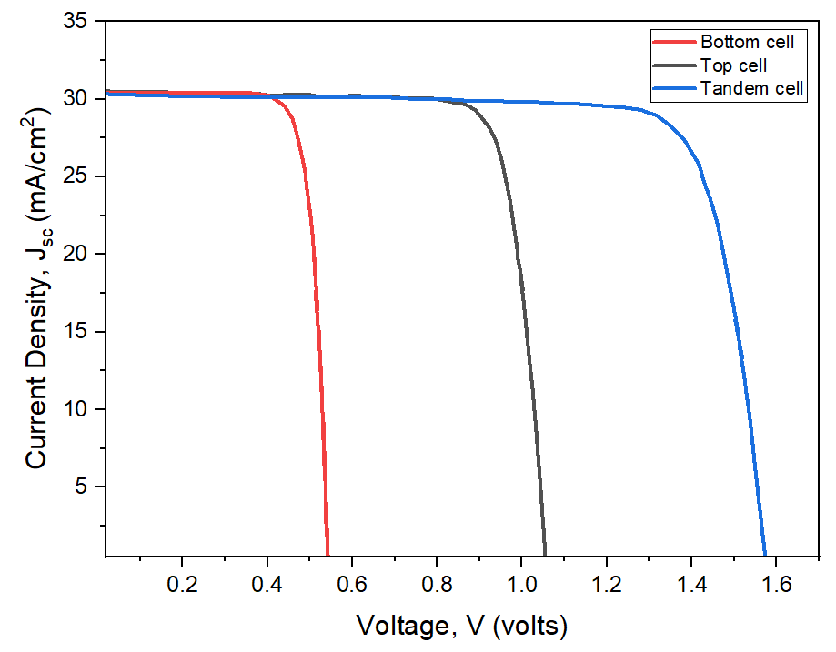
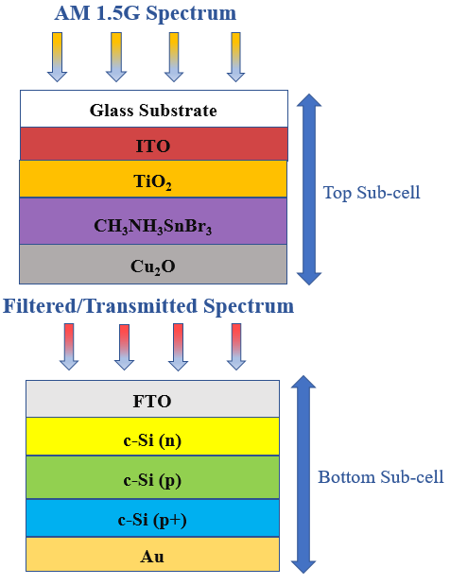
MASnBr₃/Si Tandem Cell
Simulation Output of MASnBr₃/Si Tandem Cell
Structure | V_{oc} (V) | J_{sc} (mA/cm²) | FF (%) | PCE (%)
Top Cell | 1.04 | 30.75 | 80.66 | 26.20
Bottom Cell | 0.56 | 30.53 | 80.65 | 25.84
Tandem | 1.59 | 30.56 | 80.43 | 38.86
Figure 26 : JV curve of MASnBr₃/c-Si Tandem Cell

Slide 28
Structure of GeTe Bottom Cell
Filtered/Transmitted Spectrum
FTO
CdZnS
Thickness = 50 nm
Acceptor Density = 1×10¹⁸/cm³
GeTe
Ni
Figure 27 : Structure of GeTe Bottom Cell

Slide 29
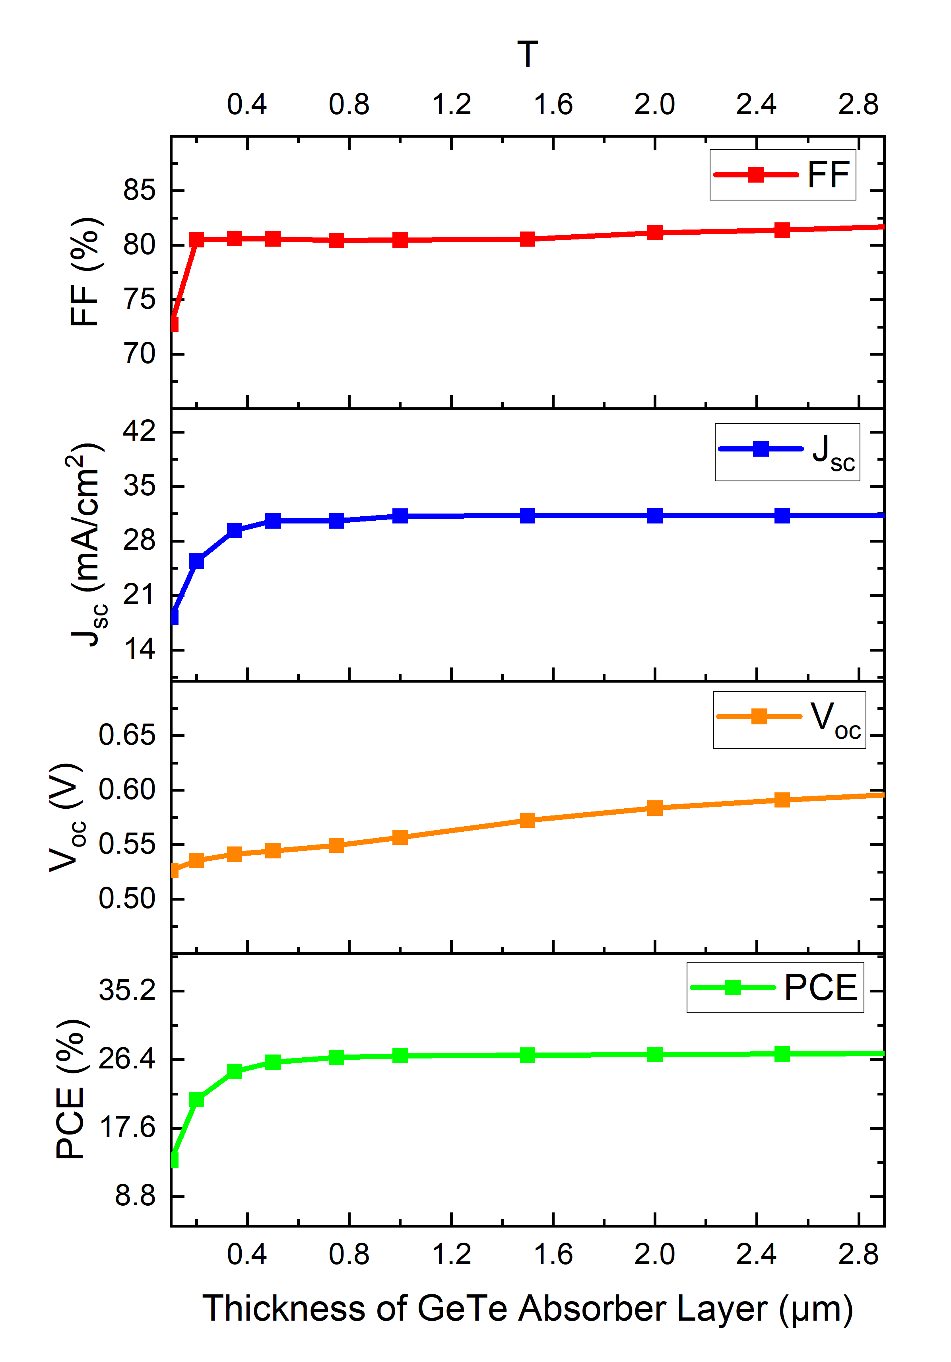
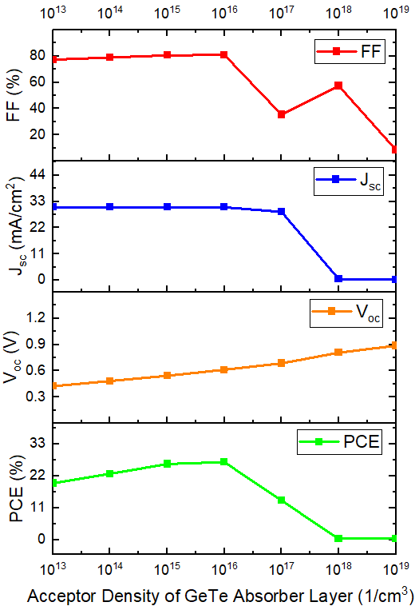
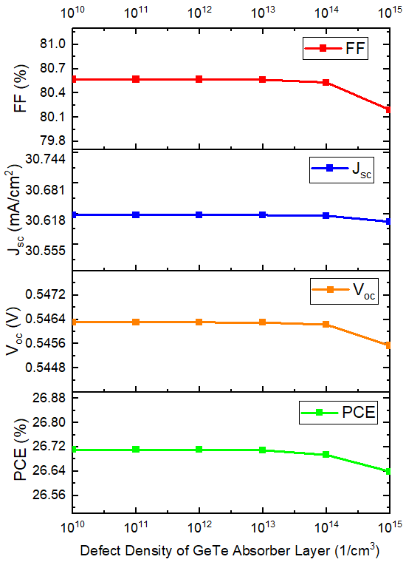
Optimization of GeTe Absorber Layer
Figure 28 : GeTe Absorber layer Thickness
Optimization
Figure 29 : GeTe Absorber layer Acceptor Density
Optimization
Figure 30 : GeTe Absorber layer Defect Density
Optimization
Thickness = 750 nm
Acceptor Density = 1×10¹⁵/cm³
Defect Density = 1×10¹³/cm³

Slide 30
Simulation Output of GeTe Bottom Cell
750 nm
Figure 31 : Current Matching for GeTe Bottom Cell
Figure 32 : JV curve of GeTe Bottom Cell
Simulation Output of Optimized GeTe Bottom Cell
V_{oc} (V) | J_{sc} (mA/cm²) | FF (%) | PCE (%)
0.55 | 30.61 | 80.57 | 26.70

Slide 31
MASnBr₃/GeTe Tandem Cell
AM 1.5G Spectrum
Glass Substrate
ITO
TiO₂
Top Sub-cell
CH₃NH₃SnBr₃
CuSbS₂
Filtered/Transmitted Spectrum
FTO
CdZnS
Bottom Sub-cell
GeTe
Ni
Figure 34 : Structure of MASnBr₃/GeTe Tandem Cell

Slide 32
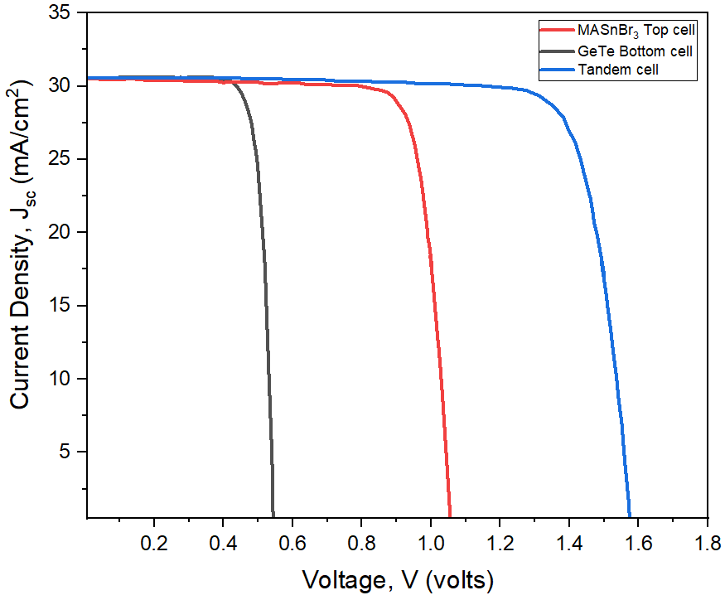
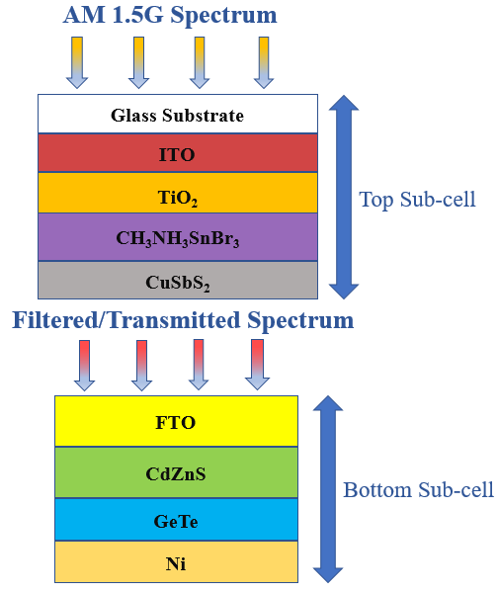
MASnBr₃/GeTe Tandem Cell
Simulation Output of MASnBr₃/GeTe Tandem Cell
Structure | V_{oc} (V) | J_{sc} (mA/cm²) | FF (%) | PCE (%)
Top Cell | 1.04 | 30.75 | 80.66 | 26.20
Bottom Cell | 0.55 | 30.61 | 80.57 | 26.70
Tandem | 1.59 | 30.62 | 80.58 | 39.20
Figure 35 : JV curve of MASnBr₃/GeTe Tandem Cell

Slide 33
Structure of CuInSe₂ Bottom Cell
Filtered/Transmitted Spectrum
FTO
WS₂
Thickness = 50 nm
Donor Density = 1×10¹⁸/cm³
CuInSe₂
MoTe₂
Thickness = 100 nm
Acceptor Density = 1×10¹⁹/cm³
Ni
Figure 36 : Structure of CuInSe₂ Bottom Cell

Slide 34
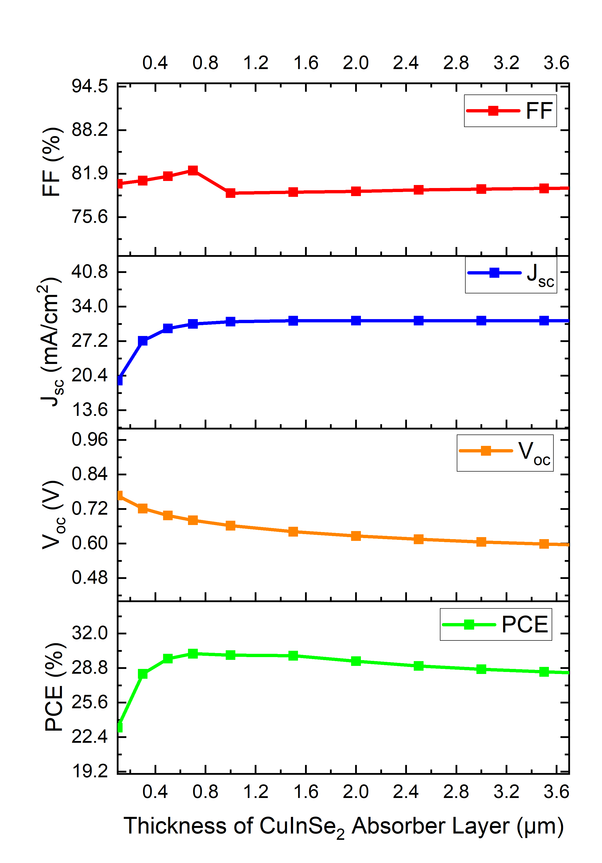
Optimization of CuInSe₂ Absorber Layer
Figure 37 : CuInSe₂ Absorber layer Thickness
Optimization
Figure 38 : CuInSe₂ Absorber layer Acceptor Density
Optimization
Figure 39 : CuInSe₂ Absorber layer Defect Density
Optimization
Thickness = 700 nm
Acceptor Density = 1×10¹⁵/cm³
Defect Density = 1×10¹³/cm³

Slide 35
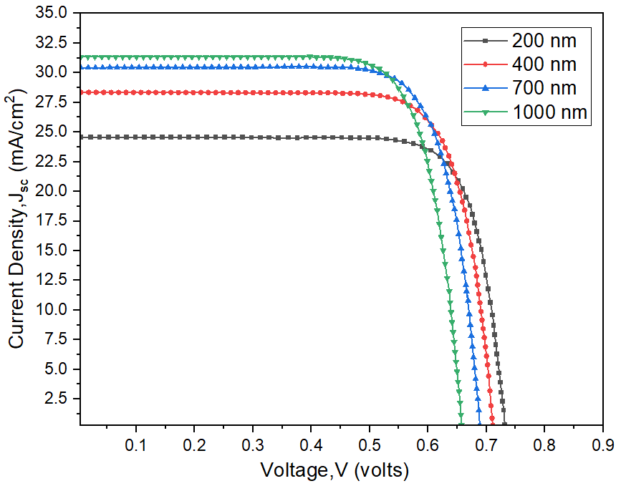
Simulation Output of CuInSe₂ Bottom Cell
700 nm
Figure 40 : Current Matching for CuInSe₂ Bottom Cell
Figure 41 : JV curve of CuInSe₂ Bottom Cell
Simulation Output of Optimized CuInSe₂ Bottom Cell
V_{oc} (V) | J_{sc} (mA/cm²) | FF (%) | PCE (%)
0.68 | 30.57 | 82.34 | 30.13

Slide 36
MASnBr₃/CuInSe₂ Tandem Cell
AM 1.5G Spectrum
Glass Substrate
ITO
TiO₂
Top Sub-cell
CH₃NH₃SnBr₃
CuSbS₂
Filtered/Transmitted Spectrum
FTO
WS₂
CuInSe₂
Bottom Sub-cell
MoTe₂
Ni
Figure 43 : Structure of MASnBr₃/CuInSe₂ Tandem Cell

Slide 37
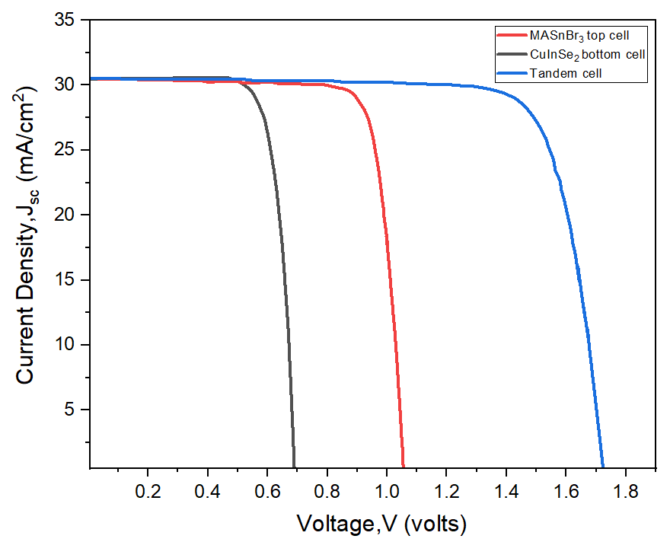
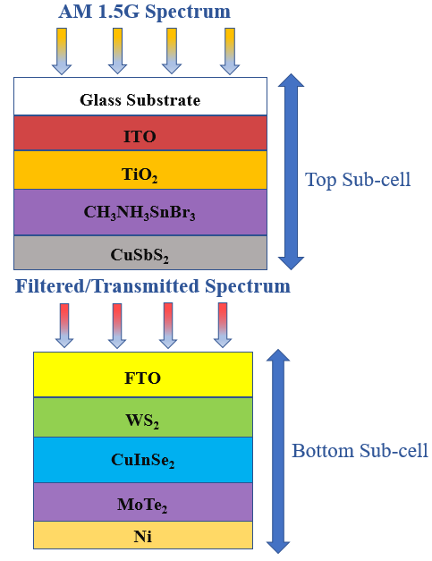
MASnBr₃/CuInSe₂ Tandem Cell
Simulation Output of MASnBr₃/CuInSe₂ Tandem Cell
Structure | V_{oc} (V) | J_{sc} (mA/cm²) | FF (%) | PCE (%)
Top Cell | 1.04 | 30.75 | 80.66 | 26.20
Bottom Cell | 0.68 | 30.57 | 82.34 | 30.13
Tandem | 1.71 | 30.58 | 80.07 | 41.68
Figure 44 : JV curve of MASnBr₃/CuInSe₂ Tandem Cell

Slide 38
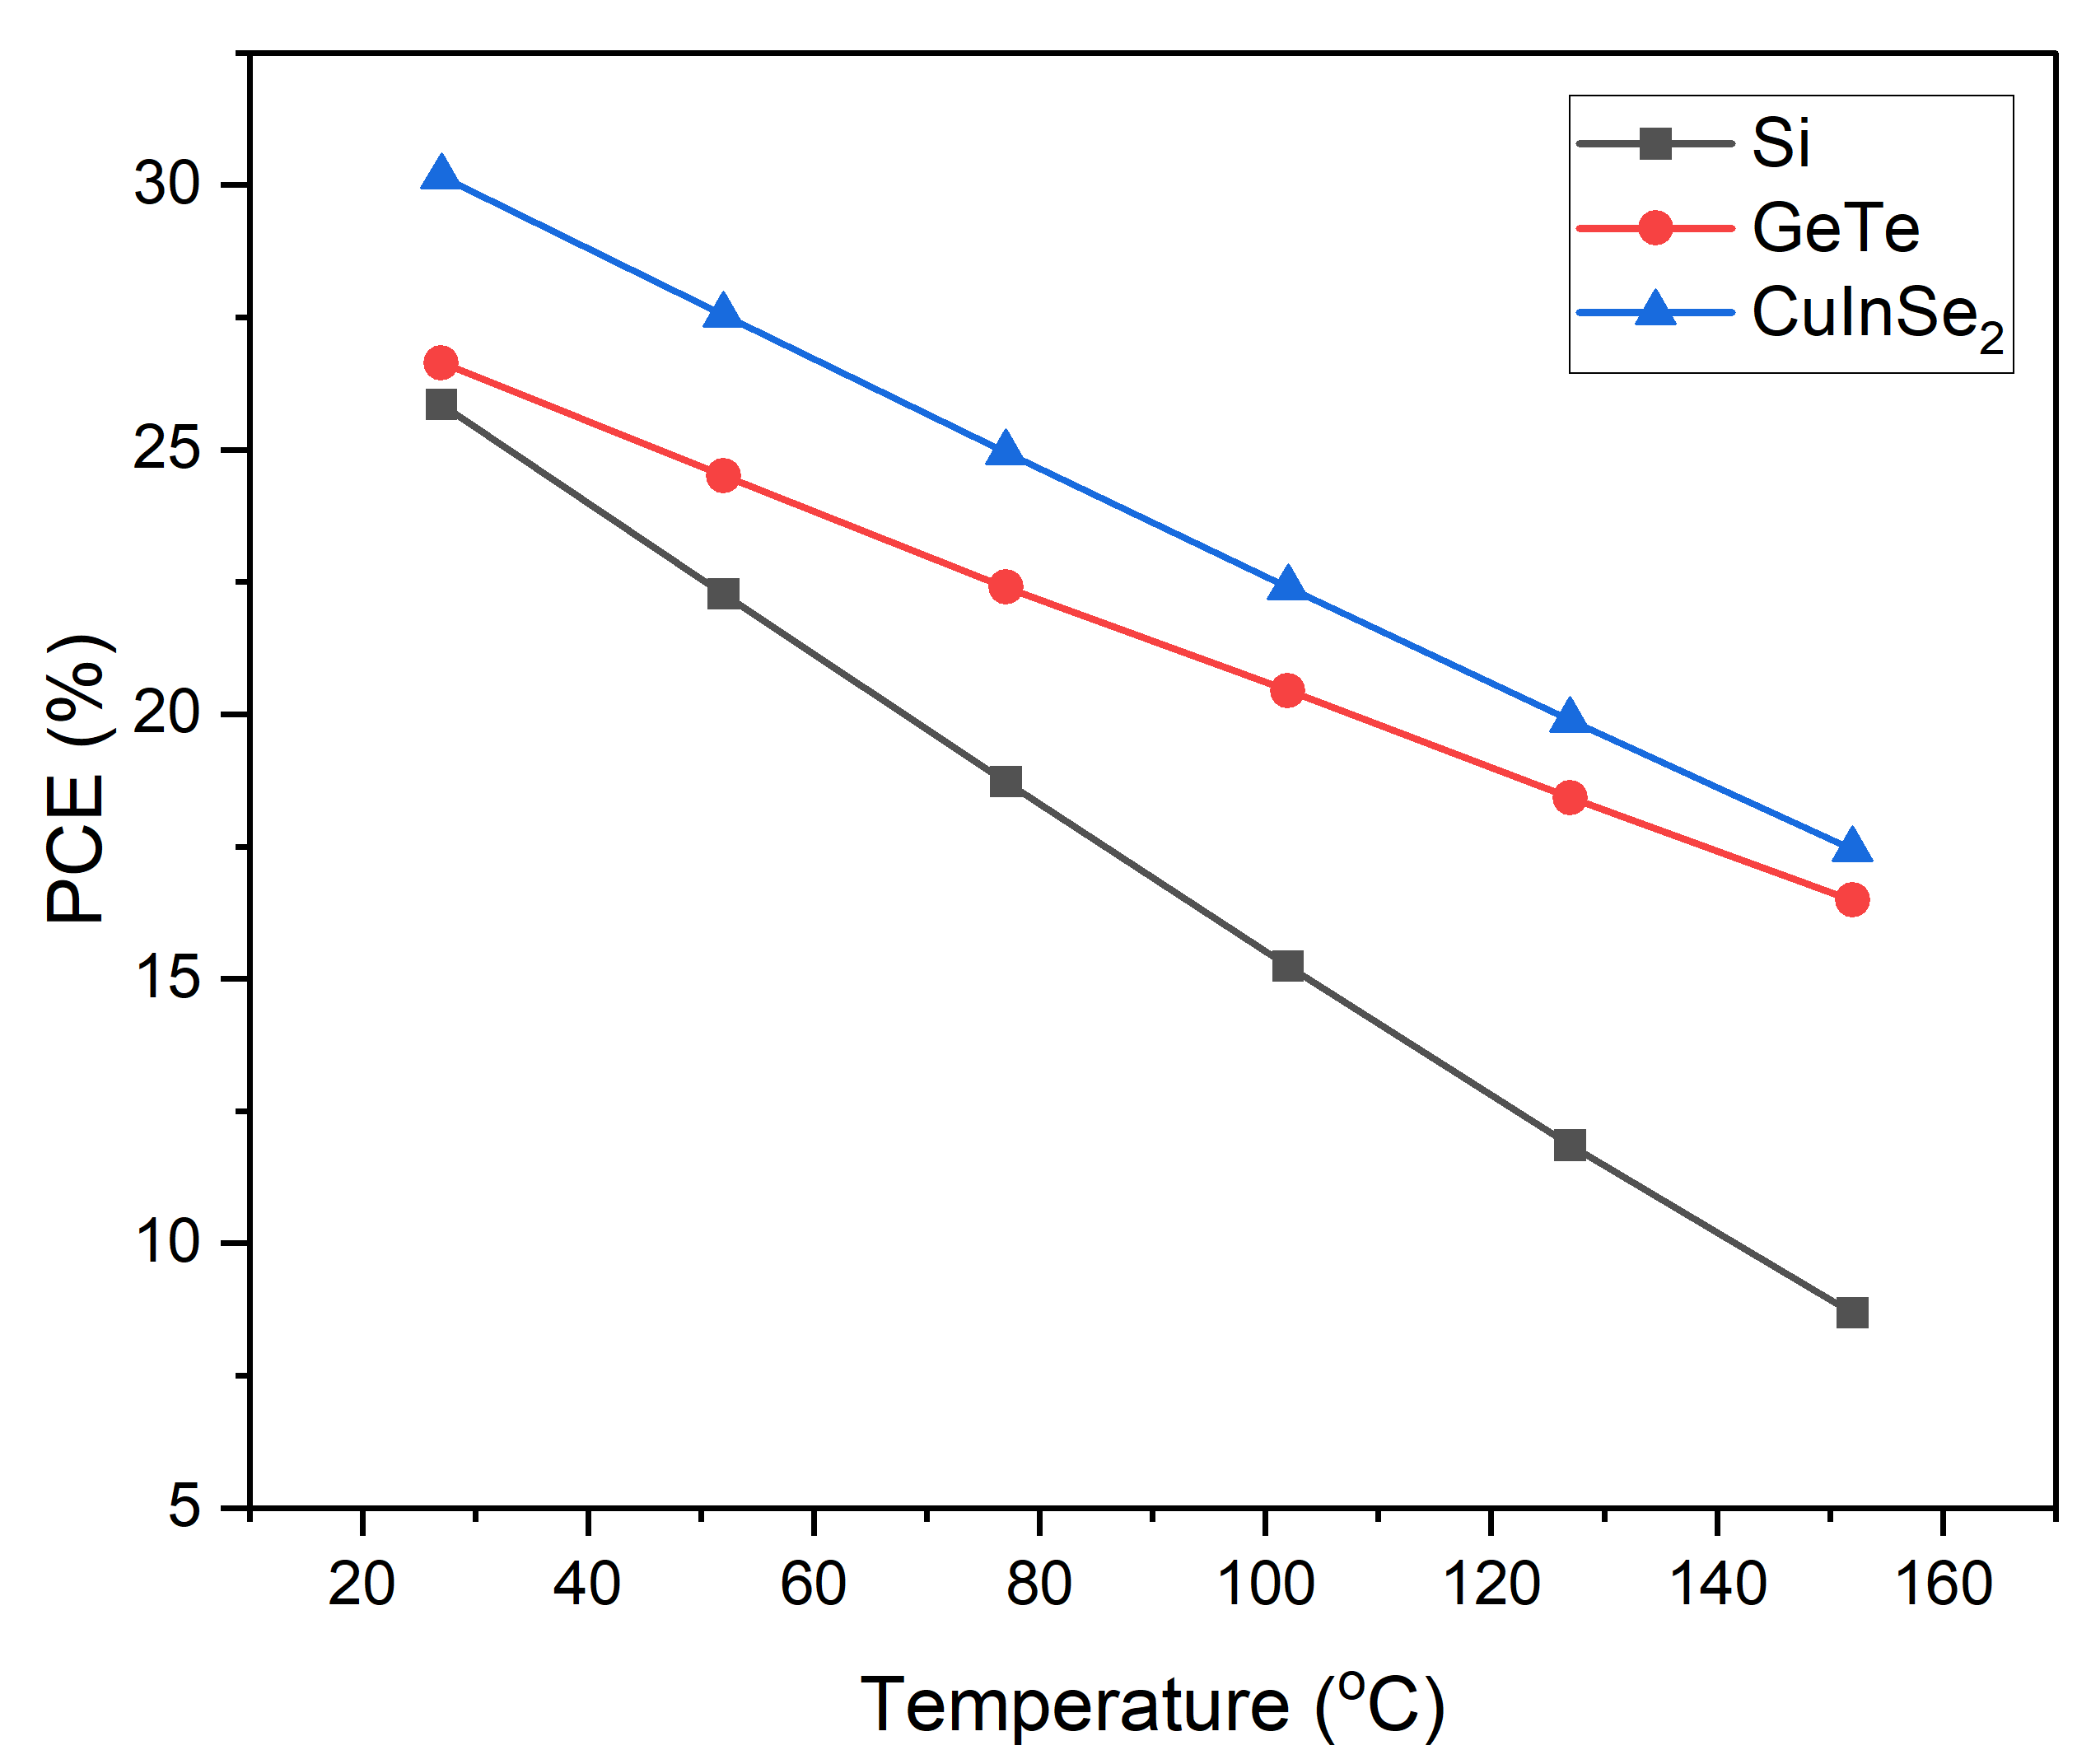
Thermal Stability of the Optimized Bottom Cells
Table : Thermal Stability of the optimized bottom cells
Bottom Cell | Efficiency at Room Temperature (27ºC) | Temperature Coefficient (per ºC)
Si | 25.84% | -0.50%
GeTe | 26.70% | -0.307%
CuInSe₂ | 30.13% | -0.335%
Figure 46 : Thermal Stability of the Bottom Cells

Slide 39
Results and Discussions
Table : Comparative study between previously published works and this work
Device Structure | V_{oc} (volts) | J_{sc} (mA/cm²) | FF (%) | PCE (%) | Ref.
Glass-base / FTO / Cd_{0.5}Zn_{0.5}S / MASnI₃ / MASnBr₃ / Au | 0.96 | 32.48 | 76.40 | 23.86 | [4]
ITO/ZnO/MASnI₃/ CuSbS₂/Ag | 0.876 | 33.19 | 76.19 | 22.16 | [5]
CH₃NH₃PbI₃ / CIGS | 1.81 | 20.49 | 81.90 | 30.50 | [9]
CH₃NH₃PbI₃ / GeTe | 1.747 | 25.88 | 79.40 | 35.90 | [10]
CH₃NH₃PbI₃ / Si | 2.11 | 20.95 | 79.45 | 35.30 | [11]
MAGeI₃ / FASnI₃ | 2.62 | 14.69 | 79.80 | 30.86 | [12]
CH₃NH₃SnBr₃ /Si | 1.59 | 30.56 | 80.43 | 38.86 | This work
CH₃NH₃SnBr₃ /GeTe | 1.58 | 30.63 | 80.58 | 39.20 | This work
CH₃NH₃SnBr₃ /CuInSe₂ (proposed) | 1.71 | 30.59 | 80.07 | 41.68 | This work

Slide 40
References
[1] Guan, Y., Yan, J., Shan, Y., Zhou, Y., Hang, Y., Li, R., ... & Hubacek, K. (2023). Burden of the global energy price crisis on households. Nature Energy, 8(3), 304-316.
[2] Zhang, H. L., Van Gerven, T., Baeyens, J., & Degrève, J. (2014). Photovoltaics: Reviewing the European feed-in-tariffs and changing PV efficiencies and costs. The Scientific World Journal, 2014.
[3] Pham, H. D., Yang, T. C. J., Jain, S. M., Wilson, G. J., & Sonar, P. (2020). Development of dopant‐free organic hole transporting materials for perovskite solar cells. Advanced Energy Materials, 10(13), 1903326.
[4] Y. Gan et al., “Numerical Investigation Energy Conversion Performance of Tin-Based Perovskite Solar Cells Using Cell Capacitance Simulator,” Energies (Basel), vol. 13,no. 22, p. 5907, Nov. 2020, doi: 10.3390/en13225907.
[5] S. Bhattarai et al., “Investigation of Carrier Transport Materials for Performance Assessment of Lead-Free Perovskite Solar Cells,” IEEE Trans Electron Devices, vol. 69, no.6, pp. 3217–3224, Jun. 2022, doi: 10.1109/TED.2022.3165516.
[6] Md. Samiul Islam et al., “Defect Study and Modelling of SnX3-Based Perovskite Solar Cells with SCAPS-1D,” Nanomaterials, vol. 11, no. 5, p. 1218, May 2021, doi: 10.3390/nano11051218.
[7] Bala, N., & Mallik, S. K. (2024). Comparative Study of Lead-free Perovskite Materials MASnI3, MASnBr3 and MAGeI3 to Design, Simulate and Optimize Lead Free PSC. Indian Journal of Pure & Applied Physics (IJPAP), 62(4), 292-303.

Slide 41
References
[8] Shrivastav, N., Kashyap, S., Madan, J., Al-Mousoi, A. K., Mohammed, M. K., Hossain, M. K., ... & Ramanujam, J. (2023). Perovskite-CIGS monolithic tandem solar cells with 29.7% efficiency: a numerical study. Energy & Fuels, 37(4), 3083-3090.
[9] Salah MM, Zekry A, Abouelatta M, Shaker A, Mousa M, Amer FZ, Mubarak RI, Saeed A. High-Efficiency Electron Transport Layer-Free Perovskite/GeTe Tandem Solar Cell: Numerical Simulation. Crystals. 2022; 12(7):878.
[10] Abedini-Ahangarkola, H., Soleimani-Amiri, S., & Rudi, S. G. (2022). Modeling and numerical simulation of high efficiency perovskite solar cell with three active layers. Solar Energy, 236, 724-732.
[10] Pandey, R., Bhattarai, S., Sharma, K., Madan, J., Al-Mousoi, A. K., Mohammed, M. K., & Hossain, M. K. (2023). Halide composition engineered a non-toxic perovskite–silicon tandem solar cell with 30.7% conversion efficiency. ACS Applied Electronic Materials, 5(10), 5303-5315.
[11] Mondol, N., Islam, K. S., Islam, M. R., & Das, S. K. (2024). Enhancing solar cell efficiency: Investigation of high-performance lead-based perovskite-on-silicon (PVK–Si) tandem solar cells through design and numerical analysis. AIP Advances, 14(1).
[12] El Arfaoui, Y., Khenfouch, M., & Habiballah, N. (2024). HTL-free non-toxic perovskite tandem solar device MAGeI3/FASnI3 with 25.69% efficiency: design and simulation using SCAPS. Journal of Optics, 1-14.

Slide 42
Thank You
Any Questions?

